Slide 1

DUH1A2 ICT Literacy Pengelolaan Informasi
Amarilis Putri Y.
Semester Ganjil – TA 2016/2017

Slide 2
Pembahasan:
1. Pengumpulan dan penyimpanan data
2. Pengumpulan dan penyimpanan informasi (tradisional, file dan basis data)
3. Data and information privacy (publish informasi di sosmed)
4. Perilaku pengamanan informasi
5. Tools kolaborasi

Slide 3
Tujuan Pembelajaran:
1. Mampu memahami proses pengumpulan dan penyimpanan data
2. Mampu memahami konsep pengumpulan dan penyimpanan informasi (tradisional, file dan basis data)
3. Mampu memahami konsep data and information privacy (publish informasi di sosmed) dan aplikasinya dalam penggunaan teknologi
4. Mampu memahami konsep perilaku pengamanan informasi dan implementasinya
5. Mengnetahui dan mampu menggunakan beberapa tools kolaborasi untuk mempermudah pekerjaan

Slide 4
Pengumpulan dan Penyimpanan Data

Slide 5
Data Vs Informasi
Data :
Raw Facts
No Context
Number or Text
Information :
Data with Cotext
Processed Data
Value-Added to Data
Summarized
Organized
Analyzed

Slide 6
Teknik Pengumpulan Data
Interview/wawancara
Kuesioner
Observasi

Slide 7
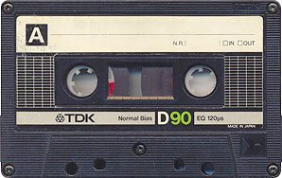
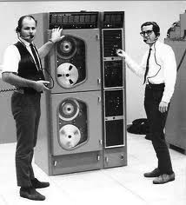
Masih ingat yang ini ?

Slide 8
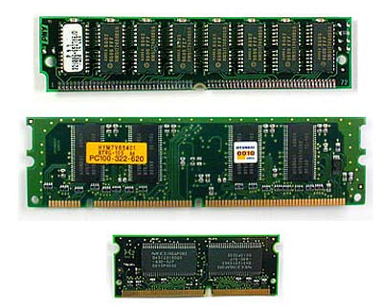
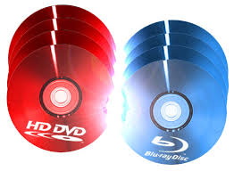
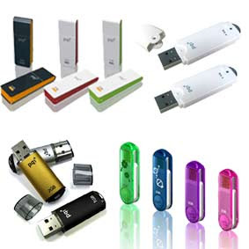
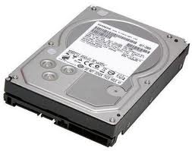
Atau ini ? ? ?

Slide 9
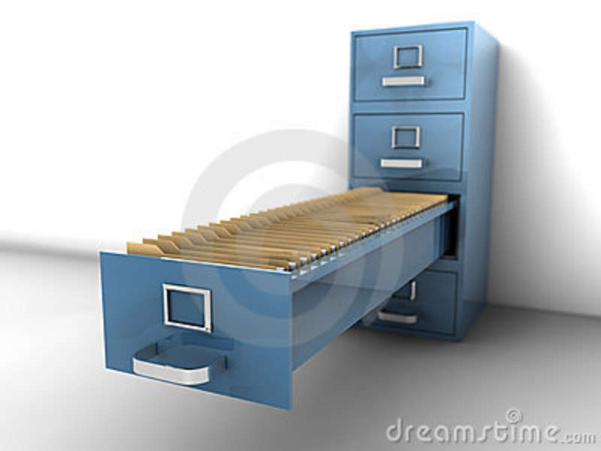
Is this file system ? ? ?

Slide 10
Data Storage
Magnetism Data Storage → https://www.youtube.com/watch?v=f3BNHhfTsvk
DBMS → https://www.youtube.com/watch?v=FR4QIeZaPeM
Relational Database Concept → https://www.youtube.com/watch?v=NvrpuBAMddw
Non Relational Database Concept → https://www.youtube.com/watch?v=pHAItWE7QMU

Slide 11
Pengumpulan dan Penyimpanan Informasi

Slide 12
Pengumpulan Informasi
Traditional Method :
Book, people,
Static
General
Only certain people or institutions become source of information
Commonly valid
Restricted
ICT era:
e-book, web based content, database
Dinamyc
More specific
Anyone can become source of information
Need to check on validity
More and more free

Slide 13
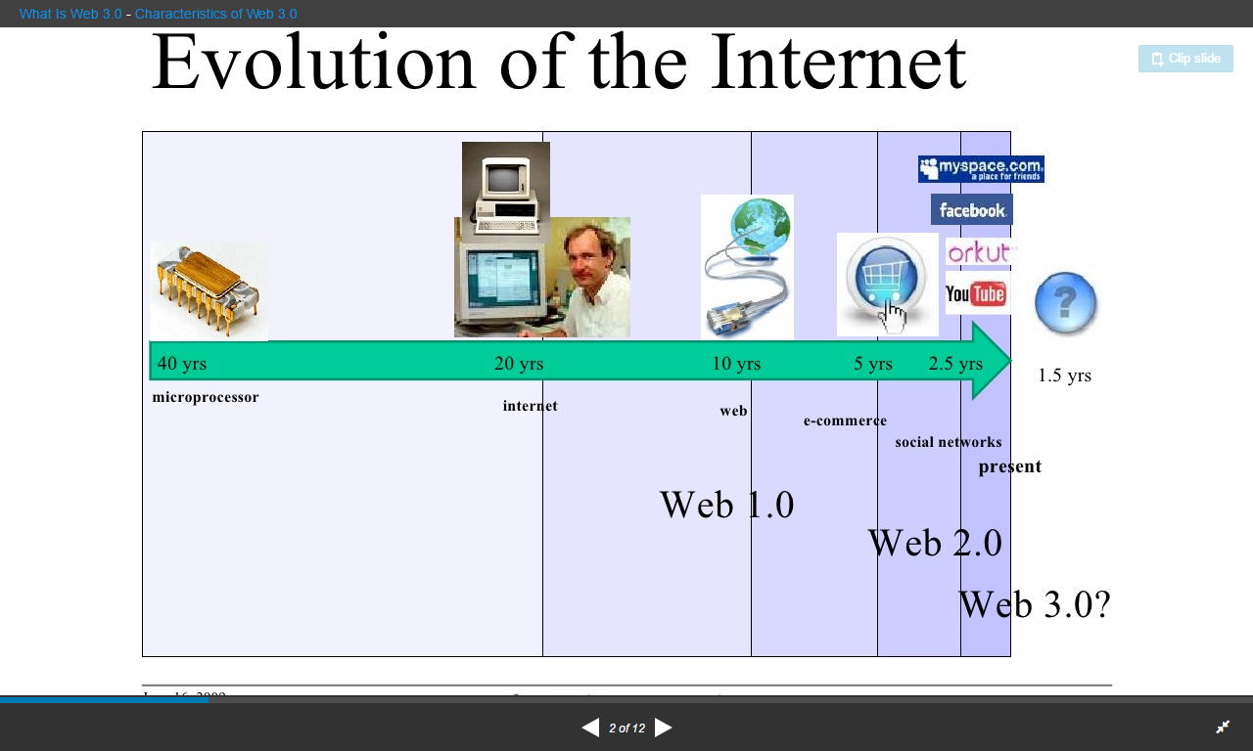
Web Technology

Slide 14
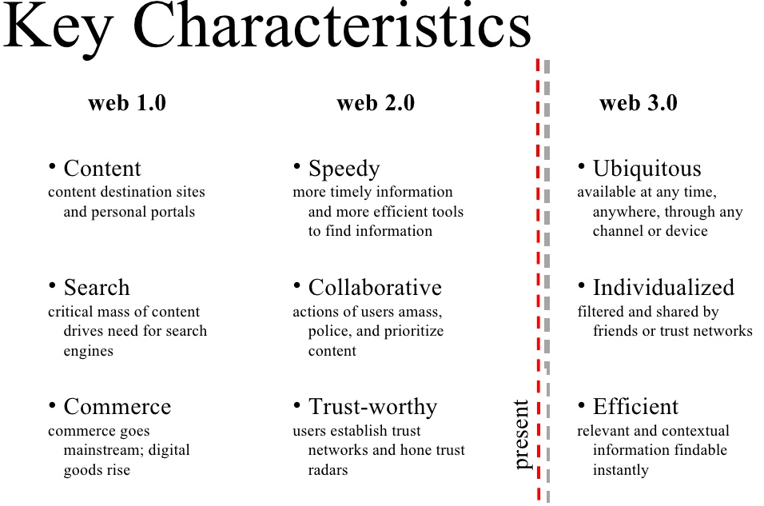
Web Technology

Slide 15
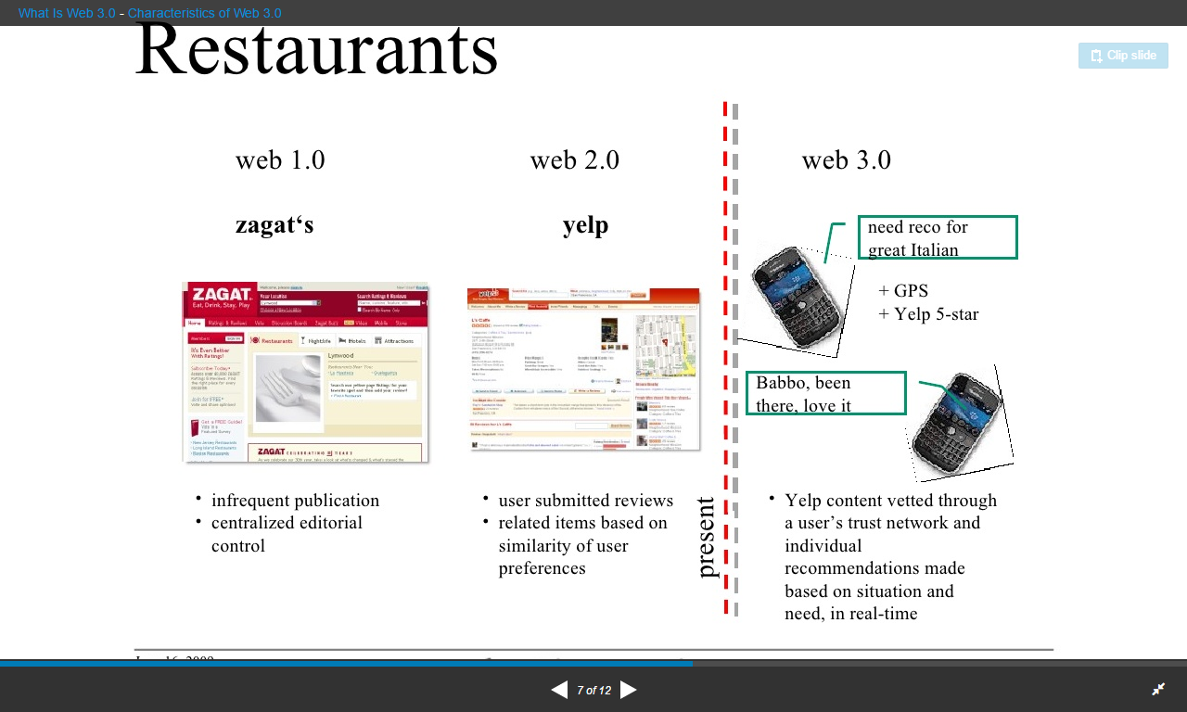
Web Technology

Slide 16
Data dan formation Privacy

Slide 17
Definition
Def. of privacy [Alan Westin, Columbia University, 1967]
= the claim of individuals, groups and institutions to determine for themselves, when, how and to what extent information about them is communicated to others
3 dimensions of privacy:
1) Personal privacy
Protecting a person against undue interference (such as physical searches) and information that violates his/her moral sense
2) Territorial privacy
Protecting a physical area surrounding a person that may not be violated without the acquiescence of the person
Safeguards: laws referring to trespassers search warrants
3) Informational privacy
Deals with the gathering, compilation and selective dissemination of information

Slide 18
Recognition of Need for Privacy Guarantee
By individuals [Cran et al. ‘99]
99% unwilling to reveal their SSN
18% unwilling to reveal their… favorite TV show
By businesses
Online consumers worrying about revealing personal data
held back $15 billion in online revenue in 2001
By Federal government
Privacy Act of 1974 for Federal agencies
Health Insurance Portability and Accountability Act of 1996 (HIPAA)

Slide 19
Threats to privacy
1) Threats to privacy at application level
Threats to collection / transmission of large quantities of personal data
Incl. projects for new applications on Information Highway, e.g.:
Health Networks / Public administration Networks
Research Networks / Electronic Commerce / Teleworking
Distance Learning / Private use
Example: Information infrastructure for a better healthcare
[cf. Danish "INFO-Society 2000"- or Bangemann-Report]
National and European healthcare networks for the interchange of information
Interchange of (standardized) electronic patient case files
Systems for tele-diagnosing and clinical treatment

Slide 20
Threats to privacy
2) Threats to privacy at communication level
Threats to anonymity of sender / forwarder / receiver
Threats to anonymity of service provider
Threats to privacy of communication
E.g., via monitoring / logging of transactional data
Extraction of user profiles & its long-term storage
3) Threats to privacy at system level
E.g., threats at system access level
4) Threats to privacy in audit trails

Slide 21
Perilaku Pengamanan Informasi

Slide 22
Privacy Control
Technical privacy controls - Privacy-Enhancing Technologies (PETs)
a) Protecting user identities
b) Protecting usee identities
c) Protecting confidentiality & integrity of personal data
2) Legal privacy controls

Slide 23
Privacy Control
1) Technical controls - Privacy-Enhancing Technologies (PETs)
a) Protecting user identities via, e.g.:
Anonymity - a user may use a resource or service without disclosing her identity
Pseudonymity - a user acting under a pseudonym may use a resource or service without disclosing his identity
Unobservability - a user may use a resource or service without others being able to observe that the resource or service is being used
Unlinkability - sender and recipient cannot be identified as communicating with each other

Slide 24
Privacy Control
b) Protecting usee identities via, e.g.: Depersonalization (anonymization) of data subjects
Perfect depersonalization:
Data rendered anonymous in such a way that the data subject is no longer identifiable
Practical depersonalization:
The modification of personal data so that the information concerning personal or material circumstances can no longer or only with a disproportionate amount of time, expense and labor be attributed to an identified or identifiable individual
Controls for depersonalization include:
Inference controls for statistical databases
Privacy-preserving methods for data mining

Slide 25
Tools Kolaborasi

Slide 26
Pentingnya tools kolaborasi
Working together
Different workplace
Monitoring and Evaluation

Slide 27
Collaboration Tools
Dropbox
Google Drive
Office Online
Asana
Trello

Slide 28
Latihan
Carilah suatu informasi dengan tema yang dikonsultasikan terlebih dahulu dengan dosen masing-masing. Simpanlah hasil informasi yang ditemukan dalam sheets mengunakan fasilitas google docs. Simpan informasinya dalam bentuk kolom-kolom. Semakin lengkap atribut/nama kolom-nya semakin baik pula informasi yang dapat dianalisis (lihat pertemuan terkait pencarian dan evaluasi kritis informasi)

Slide 29
Daftar Pustaka
http://www.slideshare.net/EinsteinX2/data-vs-information
Bharat Bhargava, Leszek Lilien, Arnon Rosenthal, Marianne Winslett, “Pervasive Trust,” IEEE Intelligent Systems, Sept./Oct. 2004, pp.74-77
https://www.youtube.com/watch?v=f3BNHhfTsvk
https://www.youtube.com/watch?v=FR4QIeZaPeM
https://www.youtube.com/watch?v=NvrpuBAMddw
https://www.youtube.com/watch?v=pHAItWE7QMU

